Slide 1
Database system
Saba Ghani
FAST-NU
Chiniot Faisalabad Campus

Slide 2
Topic
DML COMMAND
Insert delete and update operation.
Basic retrieval queries in SQL
SELECT
IN
BETWEEN
EXIST
LIKE
IS NULL

Slide 3
SQL
2: DML: Data Manipulation Language
Insert
Update
Delete
Select

Slide 4
DML Commands
Data Manipulation Languages include INSERT,DELETE and UPDATE commands.
Use to modify database
INSERT COMMAND
In its simplest form, it is used to add one or more tuples to a relation
Attribute values should be listed in the same order as the attributes were specified in the CREATE TABLE command
Constraints on data types are observed automatically
Any integrity constraints as a part of the DDL specification are enforced
Syntax: Specify the relation's name and a list of values for the tuple

Slide 5

The INSERT Command
Syntax
INSERT INTO TABLE NAME(FIELD1,FIELD2,…..FIELDN)
VALUES(VALUE1,VALUE2,…….VALUEN);
EXAMPLE INSERT INTO EMPLOYEE(Fname, Minit,Lname,SSN,Bdate,Address,Gender,MSSN,Dno) VALUES(‘Richard’,’K’,’Marini’,’653298653’,’1962-12-30’,’98 Oak Forest, Katy, Tx’,’M’,37000,’653298653,4);
OR

Slide 6
The Delete Command
Removes tuples from a relation
Includes a WHERE-clause to select the tuples to be deleted
Tuples are deleted from only one table at a time (unless CASCADE is specified on a referential integrity constraint)
The number of tuples deleted depends on the number of tuples in the relation that satisfy the WHERE-clause
Syntax DELETE from table-name WHERE Condition;

Slide 7
The Delete Command
DELETE FROM EMPLOYEE WHERE Lname=‘Brown’;
DELETE FROM EMPLOYEE WHERE SSN=‘123456789’;
DELETE FROM EMPLOYEE WHERE Dno=5;
DELETE FROM EMPLOYEE;
A missing WHERE-clause specifies that all tuples in the relation are to be deleted; the table then becomes an empty table

Slide 8
UPDATE COMMANDS
Used to modify attribute values of one or more selected tuples
A WHERE-clause selects the tuples to be modified
SET-clause specifies the attributes to be modified and their new values
Each command modifies tuples in the same relation
SYNTAX UPDATE TABLE-NAME SET ATRRIBUTE(s)=NEW VALUE WHERE CONDITION;
EXAMPLE UPDATE PROJECT SET Plocation=‘Bellaire’ AND Dnum=5 WHERE Pnumber=10;

Slide 9
BASIC RETRIEVAL QUERIES
SELECT
One basic statement for retrieving information from a database
Syntax:
SELECT columnlist FROM tablename;
Columnlist represents one or more attributes, separated by commas
Asterisk can be used as wildcard character to list all attributes.
The WHERE clause is used to extract only those records that fulfill a specified criterion.
Example
SELECT * FROM EMPLOYEE WHERE SSN=123456789;

Slide 10
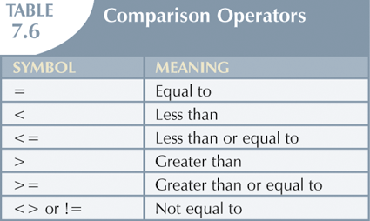
Selecting Rows with Conditional Restrictions

Slide 11
Row selection
1. Select * from EMPLOYEE
Where id=1;
2. Select * from EMPLOYEE
Where Address=‘Lahore’;
3. Select * from EMPLOYEE
Where address=‘Lahore’ AND name=‘Ali’;
4. Select * from EMPLOYEE
Where address=‘Lahore’ OR name=‘Ali’;

Slide 12
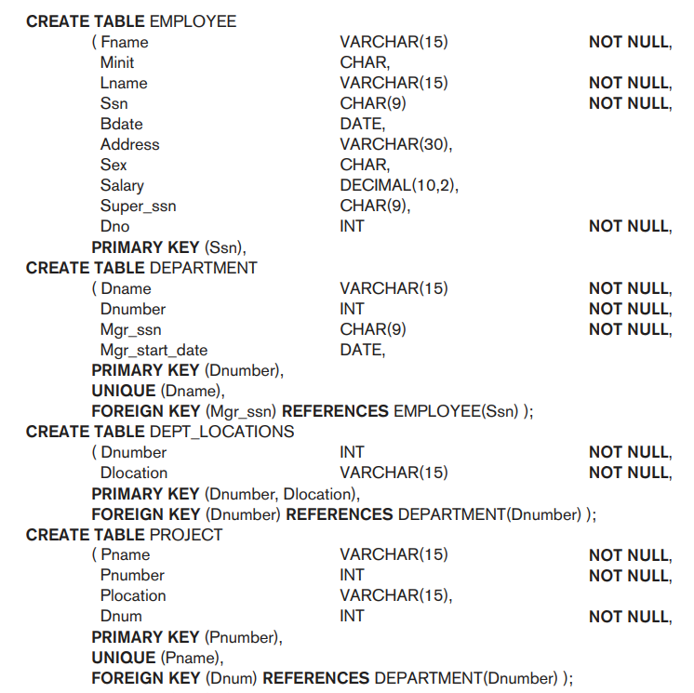

Slide 13
Specific column selection

Slide 14
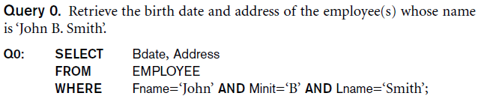
Specific column selection

Slide 15
Specific column selection

Slide 16
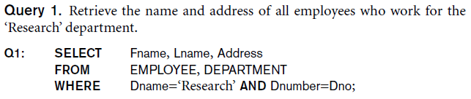
Specific column selection

Slide 17
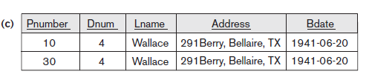


Slide 18
